Slide 1
Book Talk

Slide 2
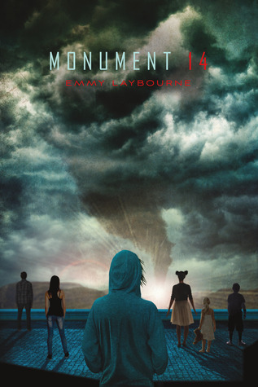
Monument 14
By: Emmy Laybourne
High school students on a bus to school one day are stopped by a massive hailstorm, and are rescued by the elementary and middle school bus. They find shelter in a grocery store in Greenway. Having to fend for themselves as the only adult leaves them to get help, they all have to work together to survive.
Book trailer: https://youtu.be/oRr6Ml-H0Xs

Slide 3
I Am The Messenger
By: Markus Zusak
A 19 year old taxi driver accidentally stops a robbery. After being viewed as a hero by the media, Ed Kennedy receives mail.
Inside an envelope is an Ace of diamonds, three addresses and times of day. Ed must decide what to do with this information while trying to make a relationship between him and the girl he is in love with work.
Book trailer: https://youtu.be/lB9xx3nfdgQ

Slide 4
I’ll Give You The Sun
By: Jandy Nelson
Twins Noah and Jude are incredibly close, but with very different personalities. Noah likes to draw, and Jude is a daredevil.
Three years later, something unexpected has driven them apart, changing both their personalities.
With each twin telling only one half of the story, they need each other to become themselves again.
Book trailer: https://youtu.be/Jd8H5Syg-yI

Slide 5
Before I Fall
By: Lauren Oliver
Samantha Kingston had the perfect life. On Friday, February 12th, everything changed. The day was supposed to be like any other, but it turned out to be her last. She has to relive the same day over and over again to try and unravel the mystery of her death, and to show her what she truly has a chance of losing.
Book trailer:

Slide 6
Slaughterhouse Five
By: Kurt Vonnegut
This book follows Billy Pilgrim’s journey as an American soldier in World War 2.
Billy becomes unstuck in time, and in no order whatsoever, he travels through time from his birth, his death, and everything in between as he tells his story.
We follow Billy through several decades. He is held as prisoner of war in Dresden, Germany and later by aliens in a zoo on a faraway planet.
Book Trailer: trailer

