Slide 1
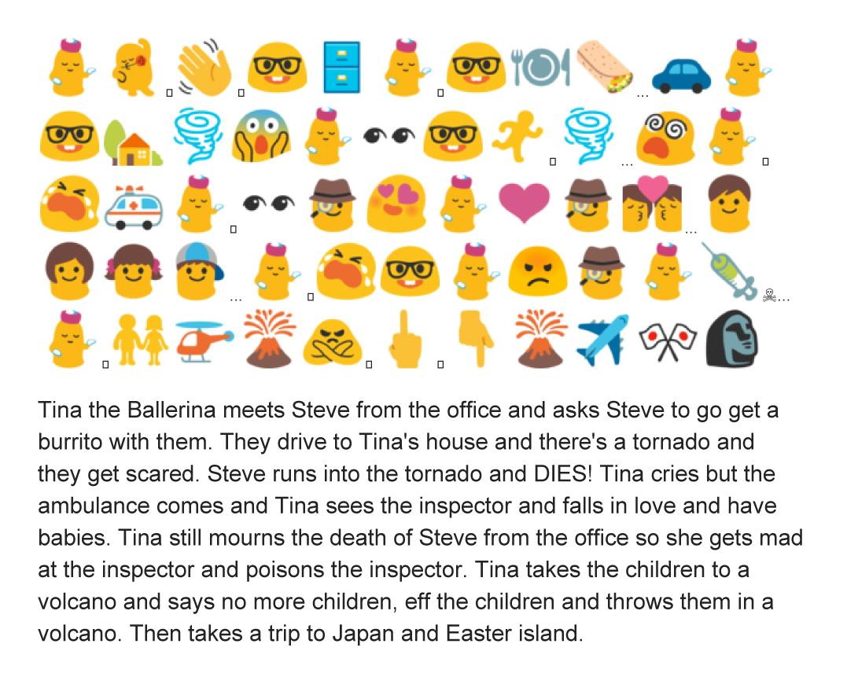
Catherine, Jessica, Sarah

Slide 2
👦💗🎸💗🏈🏠💗👪👦👧👦👧💪😍👱💖💗🐶☁☔👱👮💰🏩💤💤💤👀🏠🗻☃😱👀👯❓👆⛄🌄🎶🔍⛄❕👋☃👱⏰
Once upon a time, there was a teenage boy. He loved to play the guitar and play football. He lived at home with his loving mother and father. Many people liked this boy and he was always surrounded by large groups of people. He was very popular, because he was athletic and good looking. His dog was his best friend though, and they spent a lot of time together. One gloomy Monday morning, the boy was feeling lazy. At 7:00am, he waited for his parents to go to work, and he stayed in bed to sleep in. After he slept for a few hours, he opened his eyes and looked around. He wasn’t at home anymore! Instead, he was on a cold and snowy mountain. The boy began to panic and searched for help. Eventually, a girl, with bunny ears growing out of her head, strolled past him. He asked, “Where am I?” but didn’t say anything. She just pointed to a plump snowman at the top of this mountain. This confused boy started walking towards the snowman and as he got closer, the snowman began yelling at him. “Wake up!” he shouted and grabbed the boy’s shoulder with an icy hand. Suddenly, he was back home again. His mother hovered above him. The clock on his night stand read 7:15am.
By: Destiny L.

Slide 3
Steve had his eyes set on a girl. She had fancy things but had a kid. So Steve got a haircut, waved to her every morning, got jacked, got a pay raise, so he was a catch. The next morning he drove to her house, with a rose and asked her on a date, she said yes. Two nights later they went salsa dancing. Four nights later Steve met her kid, he did not like steve, so steve dorve home. A week later steve drove back to her house and bought the child a phone. The kid now liked Steve. He proposed and now they are married with the kid.
By: Logan, Matt, Henry, Josh, and Jaxon

Slide 4
Translation;
Jerry was a happy guy. He got very ill and cancerous. The doctors operated on his head. The tumor they got out the second time. They moved his brain out the first time. This costed a lot of money for Jerry He was mad and sad because they accidentally gave him female Hormones. He stopped being emotional and sold his soul to the devil for a for a second chance at life. He got a cat to help him cope with multiple personality disorder. He found a girl and married her. They drank a lot of wine and were not happy unless they were drunk. They yelled all the time. They had an accident they called billy. This was a mistake since they were getting a divorce. She became a prostitute in vegas and took billy. He lost all meaning to his life so he bombed the queen. He got shot in the in the bomb vest and exploded. He was rising up like an angel, but little did he know he forgot about selling his soul and the devil dragged him to hell. He is is demon now and working in a male strip club in Texas.
ALEX ZANE SHAELAH

Slide 5
Emoticon Story
QI-< *\0/* <3 O}-< :P QI-< :) XD QI-< :-C O}-< </3 :* QI-<... >:-( QI-< (*)/(*) (.V.) :-O :-Z :3 o_o :-@ X( O}-< :x :)
A girl cheerleader likes a boy who jokes about everything and the girl is always smiling and easily amused. The girl was very sad because the boy broke her heart when he kissed another girl.The girl is now angry gets on a bike and comes across an alien, she is filled with amazement but seconds later an angry face lion approaches her, the girl is shocked and starts screaming and she thinks she is going to die. Luckily the boy comes and rescues her. The two are now lovestruck and happily brought together.

Slide 6
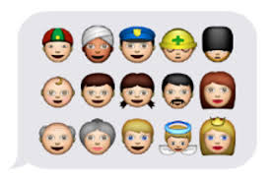
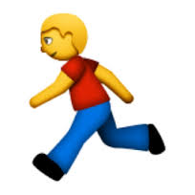
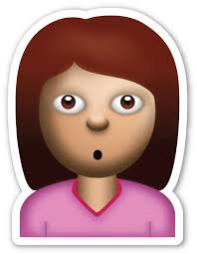
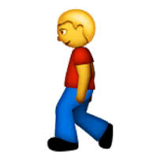
A girl sat on a bench, and read her favourite book. She got absorbed into the ink on each page, and didn’t notice the people running away from the human-sized crab parading towards her location. She looked up for a split second, and her stomach dropped like it was falling into a black hole. It crawled towards her, and their eyes made contact. The black, beady eyes of the crab bored into hers, and she felt herself feeling different. Her heart swelled, as she felt a deep connection with the crab. She walked over to it, and touched one of its’ pincers. The crab deteriorated, and there was a person standing in it’s place. She didn’t waste a second, and retrieved her book from the ground. The girl walked briskly away, leaving the person there alone.

Slide 7
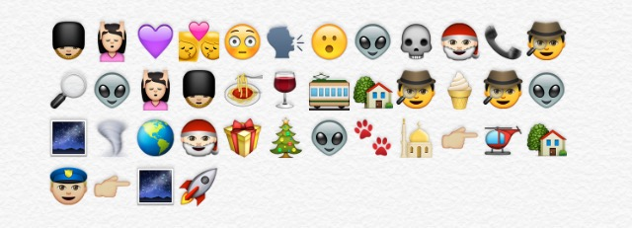
Libby, Kassey, Rachel
Bob met a girl named Tina. They kissed because he thought that they were in love. Bob was embarassed because he burped. Tina turned around in shock, to see the sight of an alien. “You can see its skull through its head!”, Tina exclaimed. Santa was also there, so they called up a detective to investigate the alien case. Tina and Bob went out for spaghetti and wine, while the detective did his thing. They took the bus home, and brought the detective some ice cream. “The alien is from space, he is on Earth because a tornado ripped him out of space”, the detective informed them. Santa was doing his regular Christmas duties and saw the alien walking on the roof of the Mosque. So I sent him on the helicopter, which crashed in your backyard. Tina called the police, so he could send the alien back to space, in a spaceship. The End.

Slide 8
Carter 😃🚇🏢☎📞😎😈😃⏳⌛⏰🚇🏠🚗🗻👀🚓🏃✊💵🚗🏠🚪✊
😃😎😎💥🔫😃💃🚗💥🔫💥🔫💥🔫📱😃😷💉💊😃💵🍔🚗
🏢😃😎🏢💥🔫💥🔫😈💥🔫😎👼😃😭👊😈💀😃🚗🏠👪💼
Kevin goes to work on the train. At work, he gets a phone call from what the Caller ID calls Coolman47. Coolman47 says that there is a terrible evil man that needs to be stopped. Kevin waits and waits until work ends. He rides on the train back home, and hops into his car. He drives to the coordinates that Coolman47 gave him. He sees a police car drive away, and runs to where it was. He sees a lot of money, so he grabs it. He drives back home. Kevin gets a mysterious knock on the door. When he opens it, two men in suits walk in. They start shooting at Kevin, but he dodges the first bullet and runs to his car. They keep shooting at Kevin. Kevin calls a nurse who stitches him up and gives him food for money. Kevin meets Coolman47 and they enter the evil man’s building. During a gunfight, Coolman47 is killed, and being his only friend, Kevin is sad. He punches the evil man, who instantly dies. Kevin returns home to his family.

Slide 9
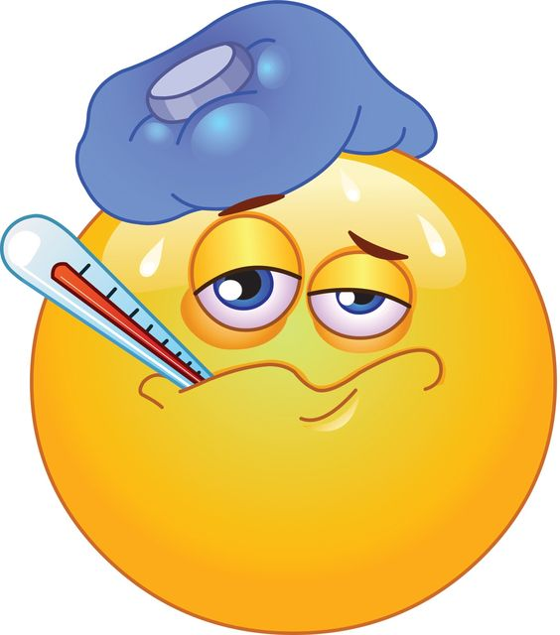
Emoji Story
By: Emily Hill
One day Joe wakes up feeling sick. He goes downstairs to eat breakfast but he starts feeling really dizzy, and faints on the stairs. Joe’s wife Jen hears the loud bang that Joe made when he fainted and she rushes to see if he’s ok. When Jen got to him, she saw that his head was bleeding, so she quickly called 911. While Jen was waiting for the ambulance she wrapped a towel around Joe’s head to try and stop the bleeding. When the ambulance arrived, they loaded Joe onto the stretcher and rushed him to the hospital. On there way to the hospital, they had to wait in a traffic jam because there was a huge car accident. When they finally got to the hospital Joe was rushed to a hospital room and his head was stitched up by a doctor. They gave him some medicine, and orange juice to help with the dizziness. He was able to go home the next day.

Slide 10
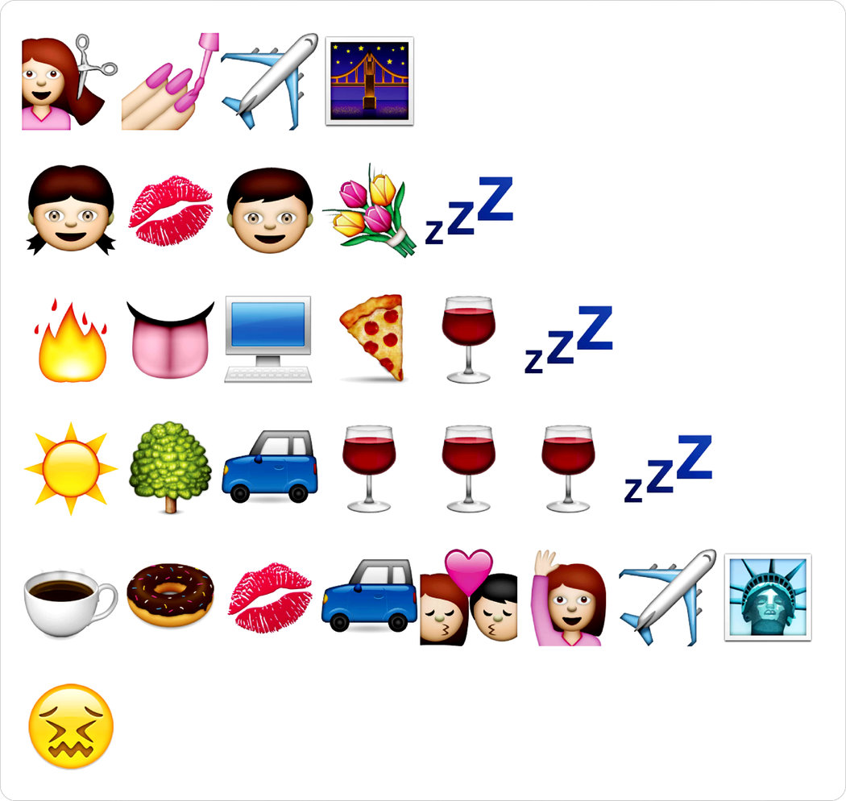
By Matt and Hugh
Barbra just had a haircut then went to the mall to get her nails done before her vacation. The next day she boards the plane that will take her to San Francisco where she will meet up with her friend Ally. Later that day with her red lipstick on, she finds a boy by the name of Bill, He hands her some flowers before she goes to sleep. The next morning she’s feeling a little naughty and goes on the computer to try and find Bill’s social media, she sits back with a slice of pizza and a glass of wine until she falls asleep. Later the next day the sun was shining and the trees are green then she drives to the bar to drink, she drinks and drinks and drinks till she passed out. She wakes up with a huge hangover so she drinks coffee and eats a donut, she puts on lipstick to try and look decent then drives to meet bill, they kiss then fall in love then she waves goodbye and they fly to NYC where she gets sick.

Slide 11
Amy & Jessica
👮🏃🚶🚓🚶🚓👊💃👮🏃💃🚑🚑💃😭👮🏃🚶🔗👐👿🚗👊🚶👮🚗🚶🏢🔒🚓👮🚓🚗🏠🏥🏦🏬⛺️👀👿🔗👐👮📞👰💔💍👮😭👊🚓✈️🏥
Once there was a police officer named Bob who chased a man who stole his police car. The man in the car hit a dancer. When the police officer ran to the dancer, an ambulance came. As the ambulance took her away, she cried. The police officer ran to the man and arrested him for theft of an automobile and hitting a person. Bob then drove the man to jail in his police car. Bob got back into his police car and drove around town, looking for more bad guys to arrest. Bob got a call from his wife saying she wanted a divorce. He was so upset he crashed his car and needed an airplane to take him to the hospital.

Slide 12
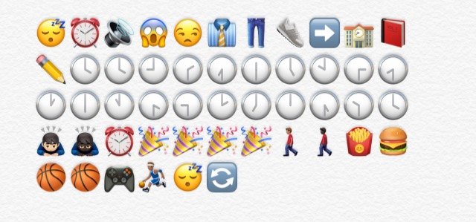
Day in the Life
We wake up in the morning from our alarms at 7:00 And get dressed for school. Then we walk to school, once we get to school learn for hours and the bell rings yaaay the day is over so we walk home but first stop at mcdonalds then we play 2k online or basketball at a gym.

