Slide 1
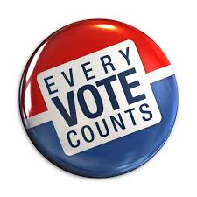
Increasing Voter Turnout
The more voters there are, the more vigorous we’ll be.
Cordelia, Devin, George, Jake & Kim
Forest Heights Collegiate Institute

Slide 2
Why do we want this?
In lots of elections, voter turnout has been disappointing with only 30% of eligible voters turning up at Kitchener’s last election in 2014 (https://www.kitchener.ca/en/insidecityhall/resources/City_of_Kitchener_-_Official_Results_-_Certified.pdf).
Voter turnout is important because if nobody turns up, the elected mayor/councillor may not reflect the citizens’ wants and needs.
Voter turnout is also important because if voters don’t turnout, the city will not be able to elect new officials, see a change in the city, and will be harder for voters to vote because the city will put less of a focus on elections.

Slide 3
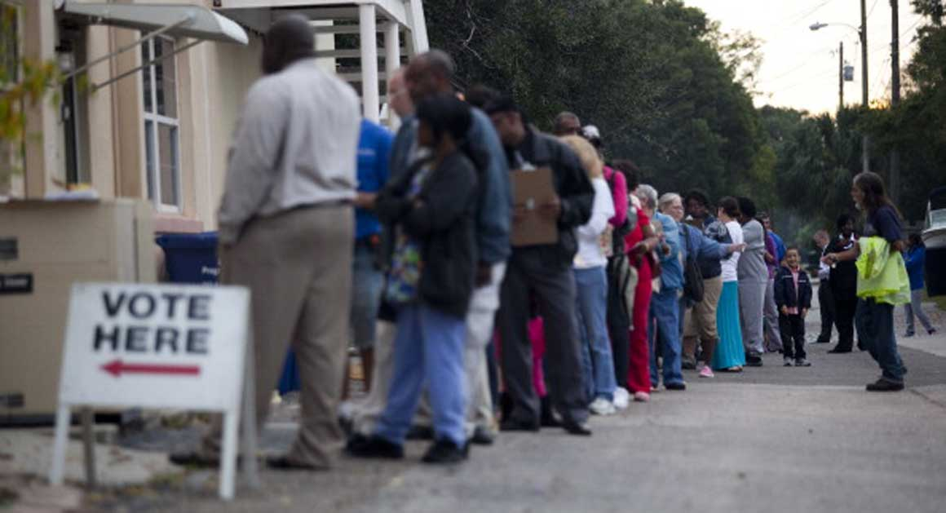
Solutions
Lowering voting age to 16
Spreading voting out over a couple of days
Allowing immigrants to vote

Slide 4
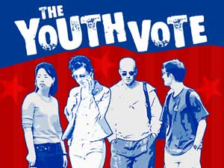
Lowering voting age to 16
If the voting age is lowered to 16, younger people will be a lot more willing to get involved in politics.
It would prepare the youth for voting in the Provincial and Federal elections.
Allowing youth to vote will help them stay politically active.

Slide 5
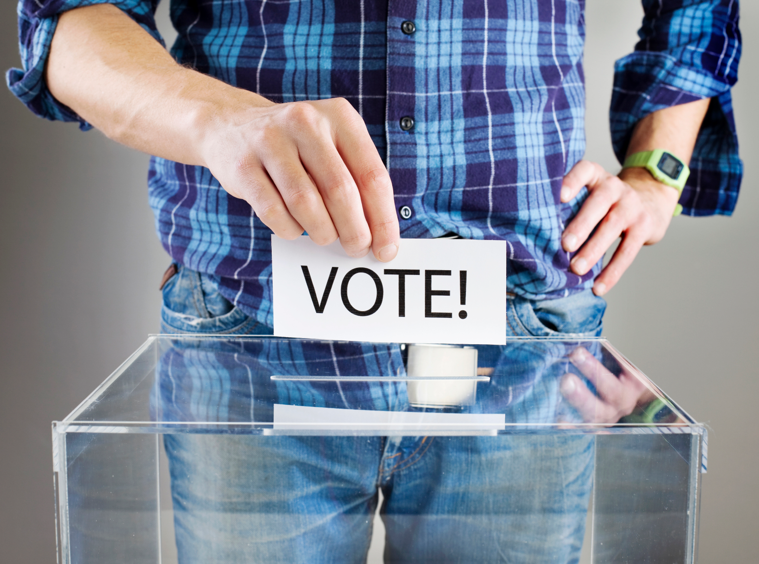
Lowering Voting Age (cont.)
This has happened in two Maryland cities, as well as several countries such as Brazil, Germany and the United Kingdom. (http://www.fairvote.org/lower_the_voting_age#why_should_we_lower_the_voting_age_to_16).
Some states and cities in Germany have also lowered the voting age to 16 such as Brandenburg, Bremen, Hamburg, and Berlin.
In Takoma Park MD, the voting turnout was four times as much among 16 year olds than 18 year olds (http://www.proyouthpages.com/voting16research.html)
There are many ways to get them out to vote. There could be concerts targeted at youth in support of voting. There could also be a voting event on a social media platform that would bring the youths attention to the election.

Slide 6
Spread out voting to two days
By increasing the elections from one day to two, it would increase the time that people have to vote.
A reason why people are not voting is that they are busy on the voting day, so this will give a better opportunity for everyone.
This will give people more time to vote and will take off some pressure on people to vote right away.
People will treat it more seriously if the event is more than one day, because events that are multiple days have bigger turnouts.

Slide 7
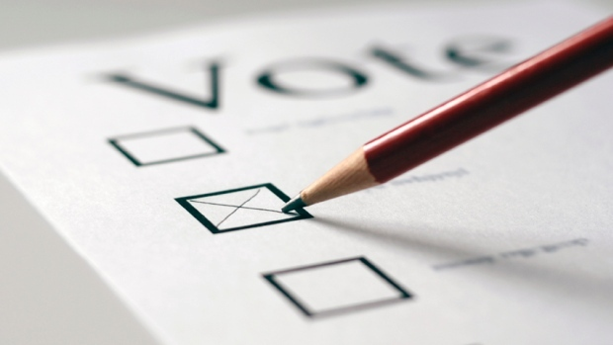
Advantages of Two-Day Voting
In our research we found that voter turnout can be decreased by the fact that some people cannot take the day off from work to vote
If the voting is spread out to a Friday and Saturday it gives people a weekday and weekend to take the day off and vote

Slide 8
Costs of Two Day Voting
In 2014 the election cost was $352 868
Using this number we can estimate that two day voting will cost about $529 302 if it was to be implemented in 2018

Slide 9
Allowing Immigrants to Vote
Another way to increase voter turnout is to allow non-citizen immigrants to vote in municipal elections.
About 25% of Kitchener’s population are immigrants (http://www.cbc.ca/news/canada/kitchener-waterloo/almost-25-of-waterloo-region-s-population-is-foreign-born-1.1375302), so this would allow more people to vote, increasing voter turnout.
It would give immigrants a reason to care about politics.
If immigrants are more involved in politics then they will more likely want to get involved in other things in the community.
Giving immigrants extra rights will encourage immigrants to come to Kitchener.
According to Mohammed Nawaz, a teacher at immigration services in Halifax, giving landed immigrants the vote will help voter turnout. (http://atlantic.ctvnews.ca/should-non-citizens-be-allowed-to-vote-in-municipal-elections-1.1948841)

Slide 10
How it will help our community
It will allow more people’s voices to be heard
It will make the votes more accurate as more people will be contributing
It will force municipal politicians to take more people’s views into account
It will allow the people who are free to vote to be more active in the community
It allows people to understand what is happening in the community

Slide 11
Increasing Voter Turnout
The more voters there are, the more vigorous we’ll be.
Cordelia, Devin, George, Jake & Kim
Forest Heights Collegiate Institute

